Slide 1
UIT2301 – Programming and Design Patterns
Lecture-04
Decorator Design Pattern
Object Structural

Slide 2
Introduction
Intent:
Attach additional responsibilities to an object dynamically. Decorators provide a flexible alternative to subclassing for extending functionality.
Also Known As:
Wrapper

Slide 3
Introduction
Motivation:
Sometimes we want to add responsibilities to individual objects, not to an entire class.
Example: A graphical user interface toolkit should let you add properties like borders or behaviors like scrolling to any user interface component.
A more flexible approach is to enclose the component in another object that adds the border. The enclosing object is called a decorator.

Slide 4
Introduction
Applicability :
to add responsibilities to individual objects dynamically and transparently, that is, without affecting other objects.
for responsibilities that can be withdrawn.
when extension by subclassing is impractical. Sometimes a large number of independent extensions are possible and would produce an explosion of subclasses to support every combination. Or a class definition maybe hidden or otherwise unavailable for subclassing

Slide 5
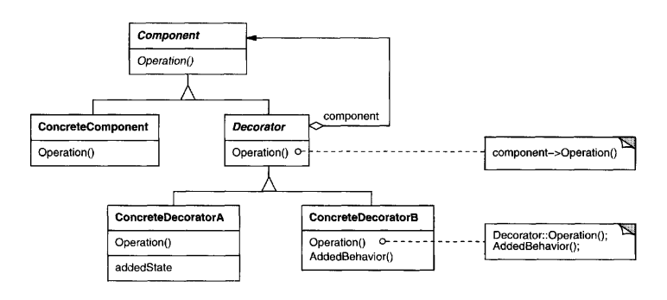
Introduction
Structure

Slide 6
Introduction
Participants
Component (VisualComponent) - defines the interface for objects that can have responsibilities added to them dynamically.
ConcreteComponent (TextView) - defines an object towhich additional responsibilities can be attached.
Decorator - maintains a reference to a Component object and defines an interface that conforms to Component's interface
ConcreteDecorator (BorderDecorator, ScrollDecorator) - adds responsibilities to the component

Slide 7
Introduction
Consequences:
More flexibility than static inheritance.
Avoids feature-laden classes high up in the hierarchy.
A decorator and its component aren't identical.
Lots of little objects.

Slide 8
Implementation
Getters/ Setters -> @property
Activity01:
Writing simple codes in python using get() and set()

Slide 9
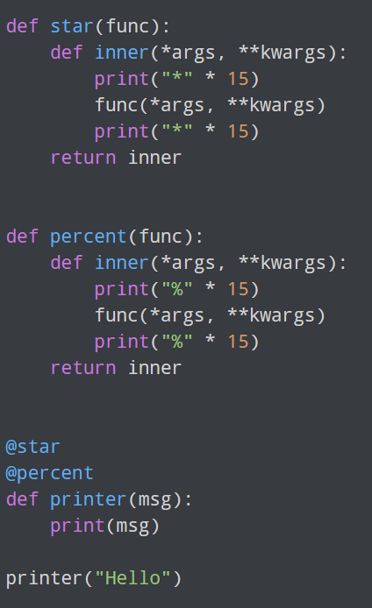
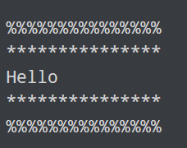
Chaining decorators
Multiple decorators can be chained in Python.

Slide 10
Books
TEXTBOOKS:
Dusty Phillips, “Python 3 Object-Oriented Programming: Build robust and maintainable software with object-oriented design patterns in Python 3.8”, Third Edition, Packt Publishing, 2018.
REFERENCES:
Matt Weisfeld, “Object-Oriented Thought Process”, Fifth Edition, Addison-Wesley Professional, 2019.
Matthias Noback, “Object Design Style Guide”, Manning Publications, 2020.
Stephen F. Lott, “Mastering Object-oriented Python”, Second Edition, Packt Publishing, 2019.
Mark Lutz, “Programming Python: Powerful Object-Oriented Programming”, Fourth Edition, O’Reilly Media, 2011.

